Slide 1
Lire Assignment
Miguel Pérez
David Burrell
Rodrigo Pueblas
Ángel Igareta

Slide 2
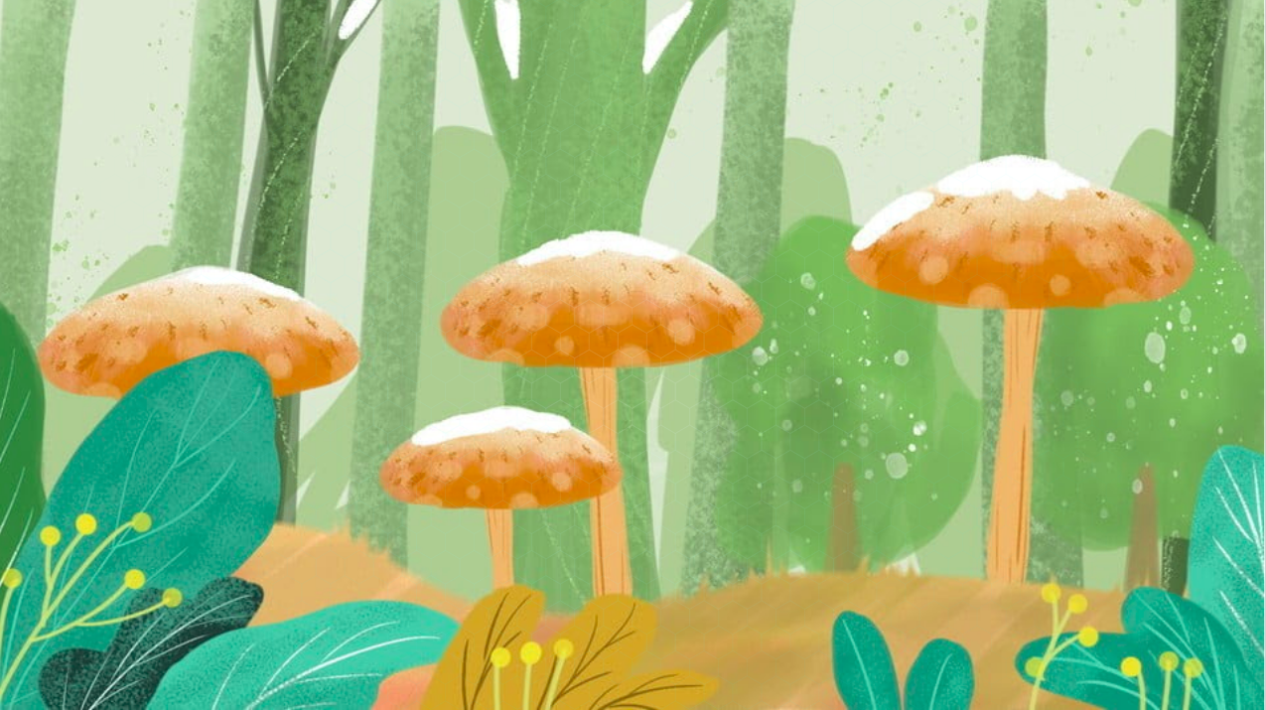
LIRE application:
Out application is an image indexing application which allows the user to know the toxicity edibility of any mushroom photographed.
The main problem for a lay person who collects mushrooms is to identify properly each mushroom in order to avoid intoxications.
Our application will serve as a reliable tool to perform this type of analysis only based on a single provided image.

Slide 3
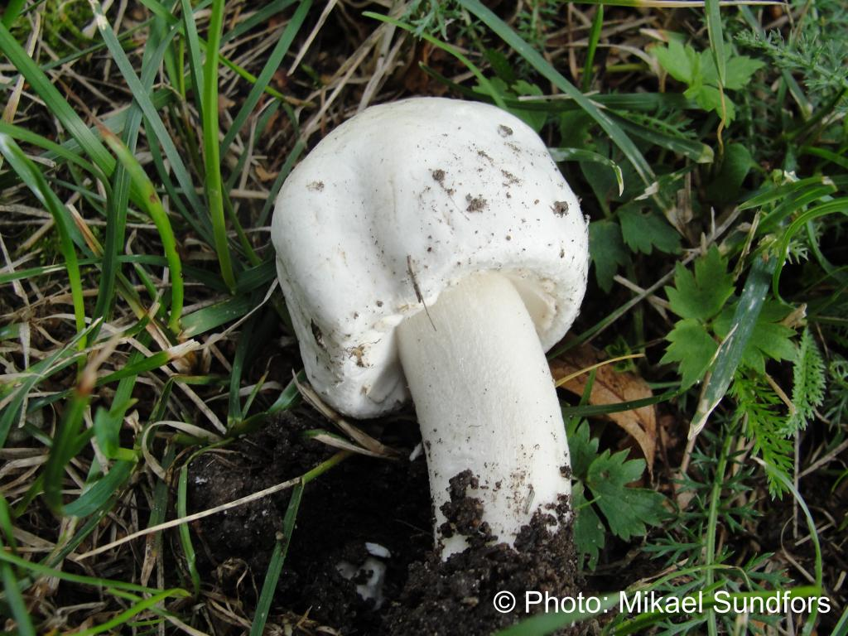
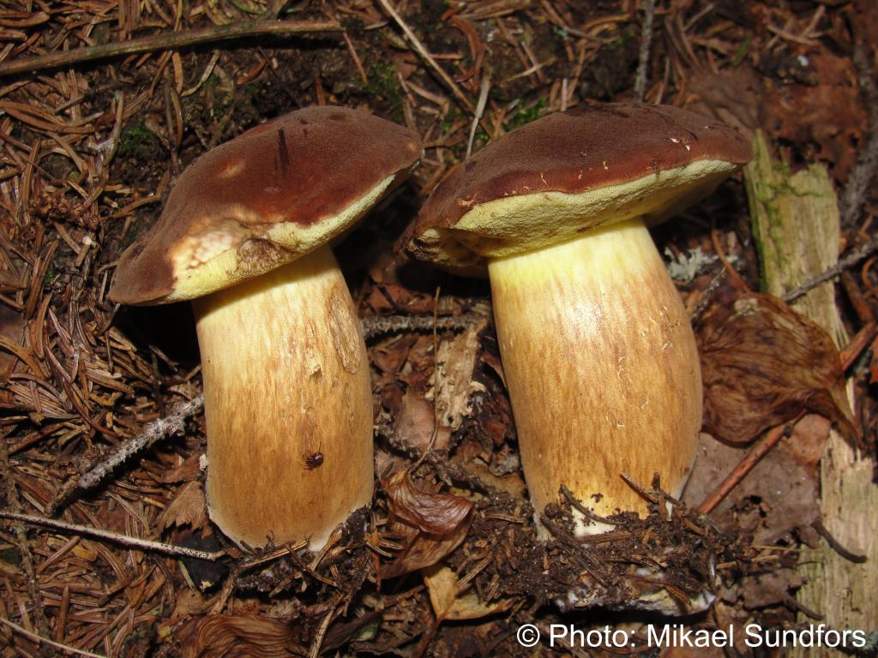
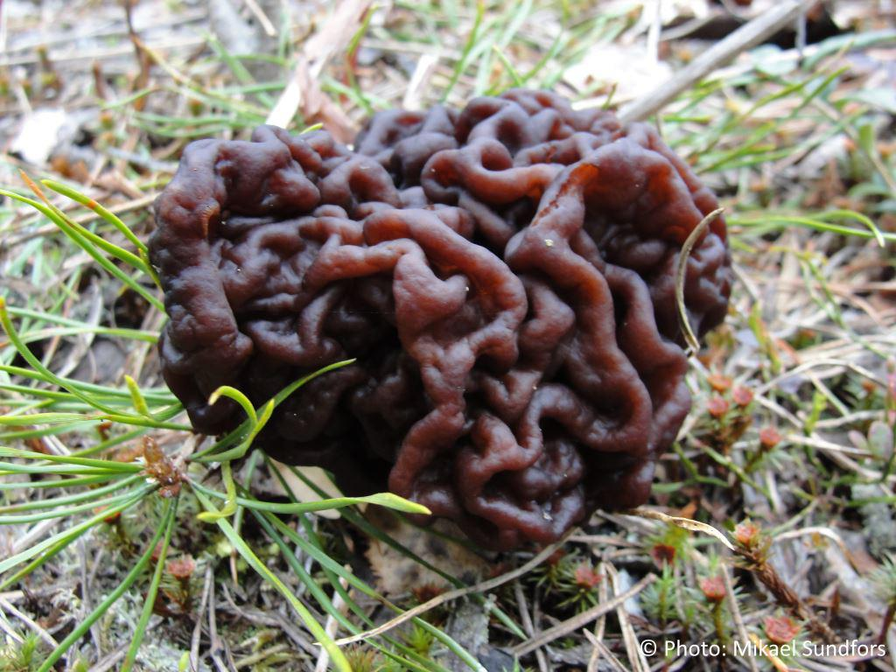
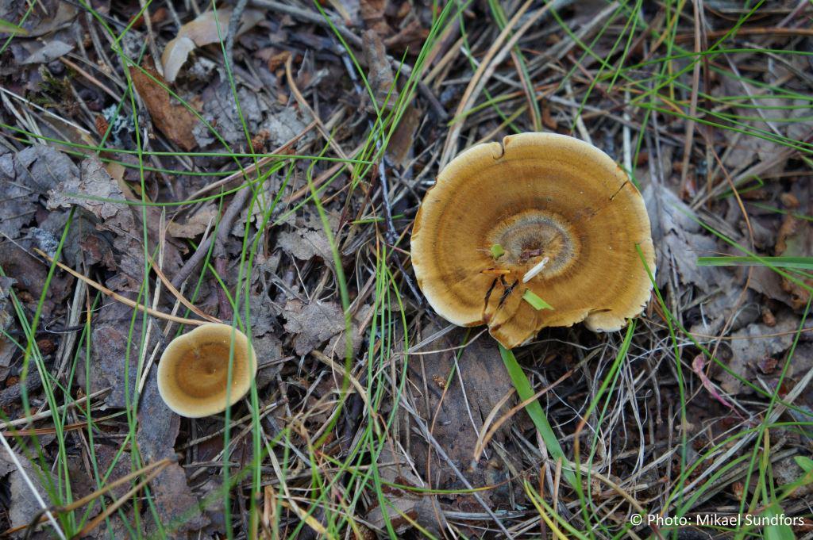
Our Dataset
Our dataset consists in the result from scraping the web: http://www.mushroom.world/
We reused an open source implementation from a group of students from Helsinki.
Although 626 images where scarpaed, due to memory issues only 26 were used in the final testing
Mercury is the closest planet to the Sun

Slide 4
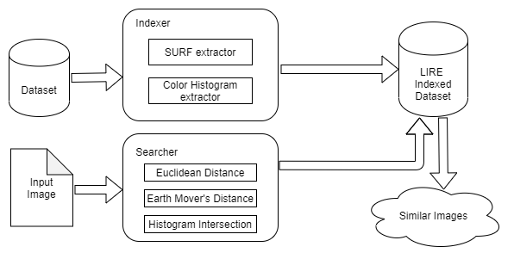
Application Schema:

Slide 5
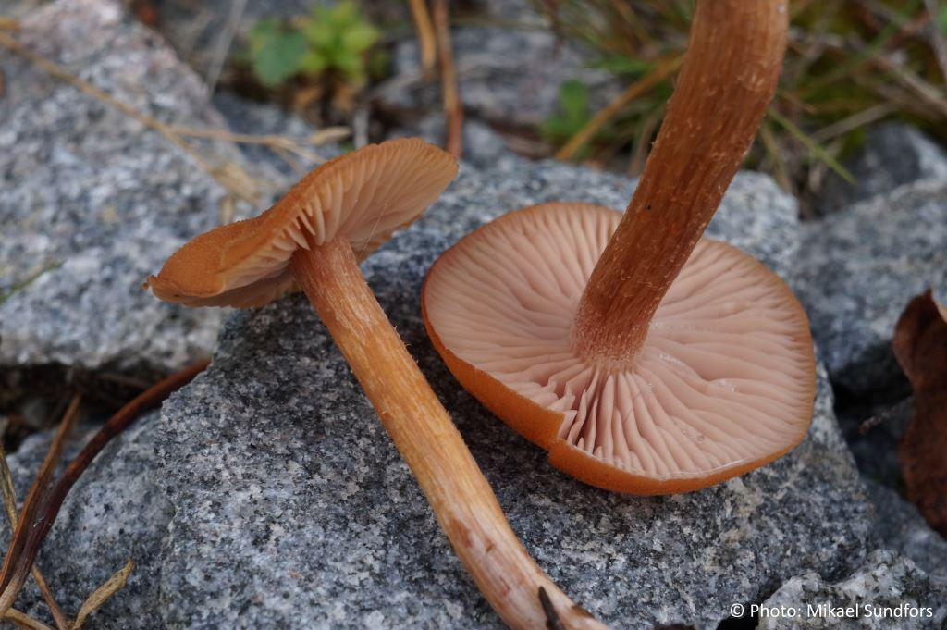
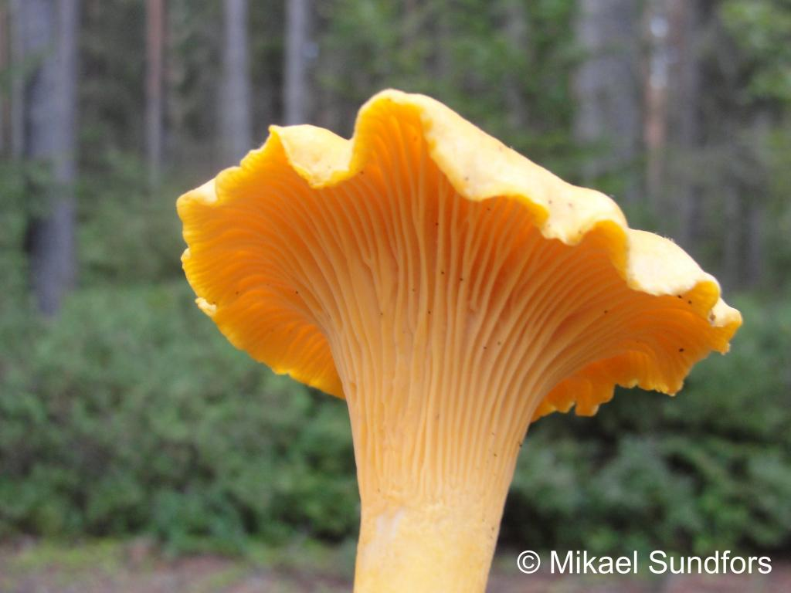
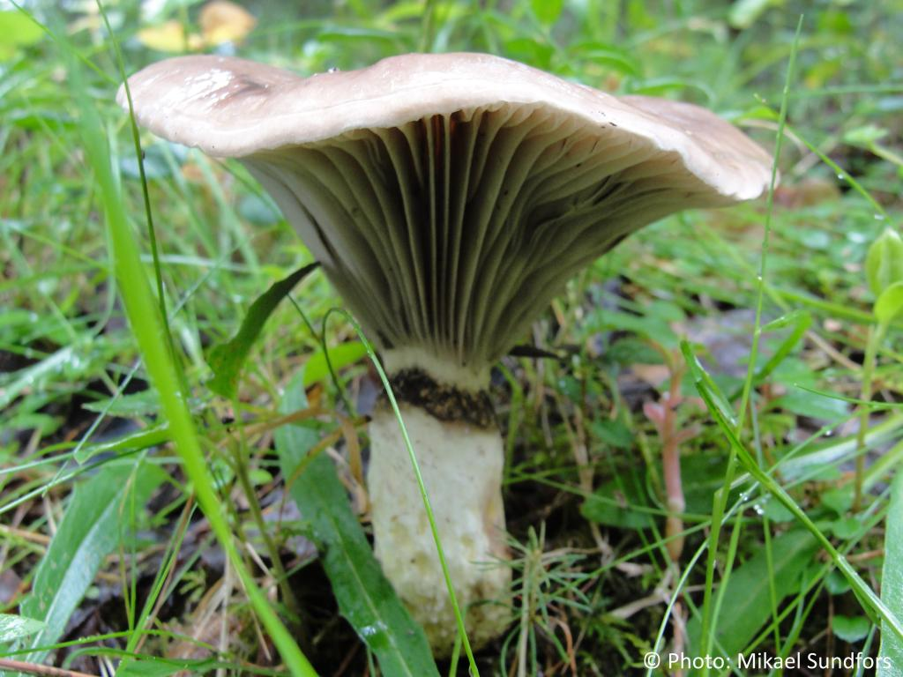
Defined Metric
Three categories depending on the output images
Category | Result | Example
Same species is returned as the first result. | 14/26 = 54% | Laccaria Lacata¹
Same species is returned within the first ten results (but not first). | 9/26 = 35% | Cantharellus Cibarius²
Same species is not within the returned ones. | 3/26 = 11% | Gomphidius Glutinosus³
Top1 result (1)
Top10 result (2)
None result (3)

Slide 6

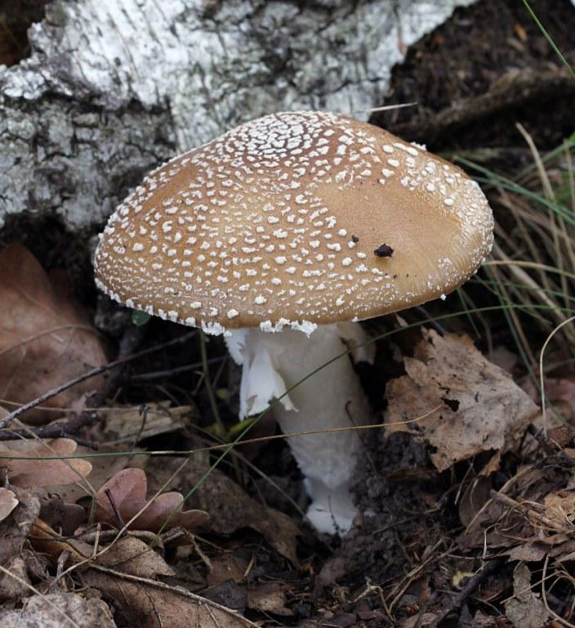
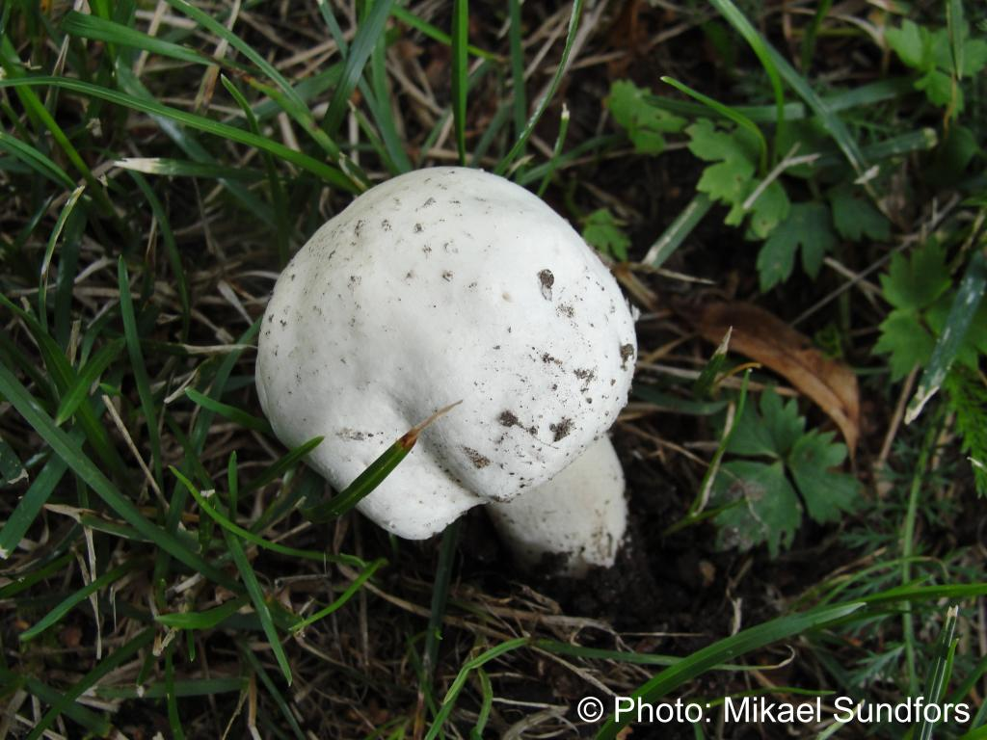
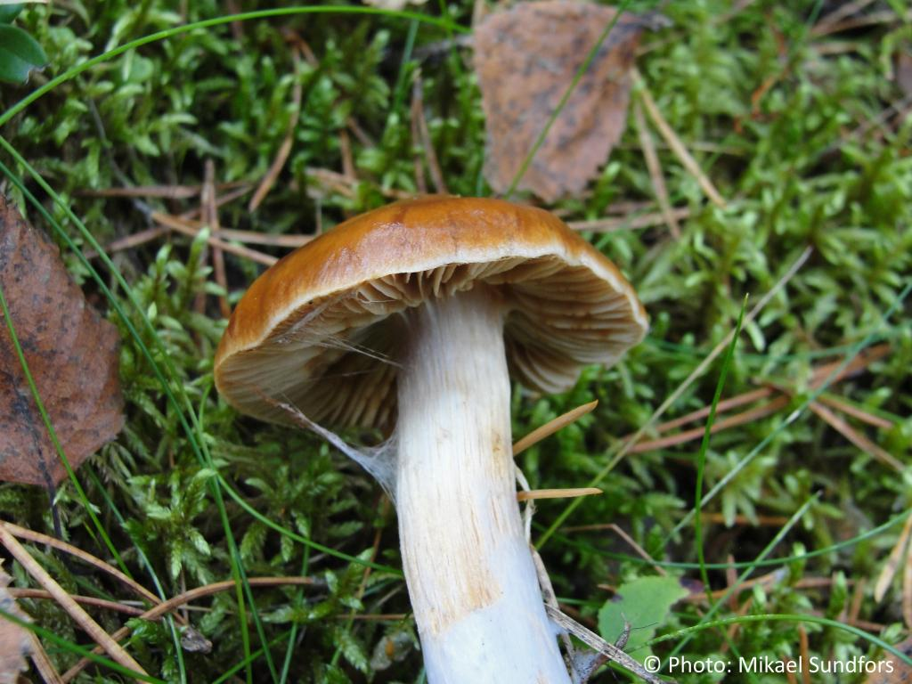
Results for Agaricus Arvensis (0)
On the left, you can see the input image, and on the right you can see the similar images retrieved.
º
Agaricus Arvensis (1)
Score: 308.40
Amanita Pantherina (0)
Score: 621.66
Cortinarius Collinitus (2)
Score: 667.02

Slide 7
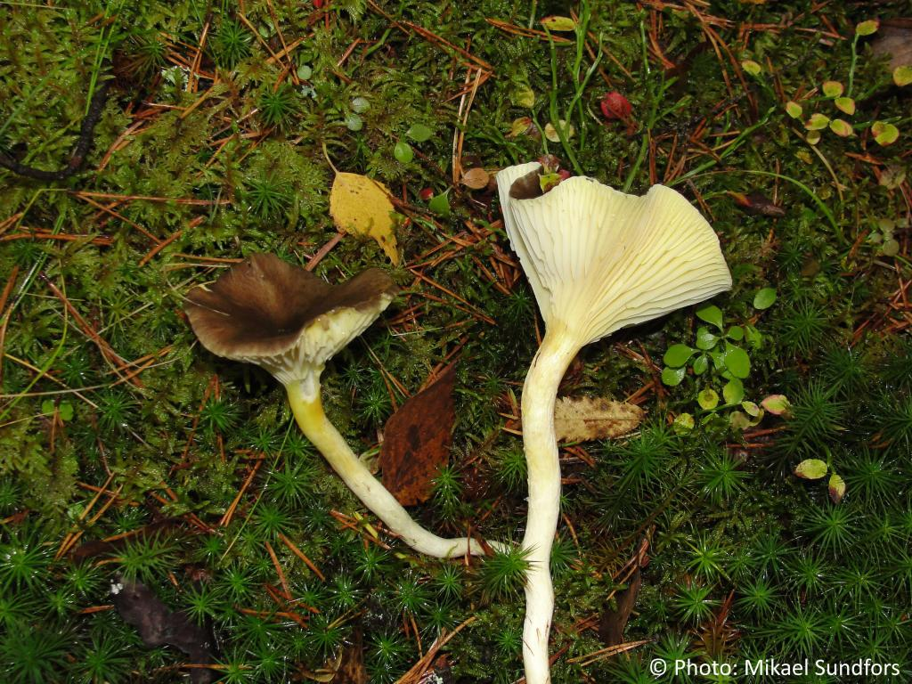
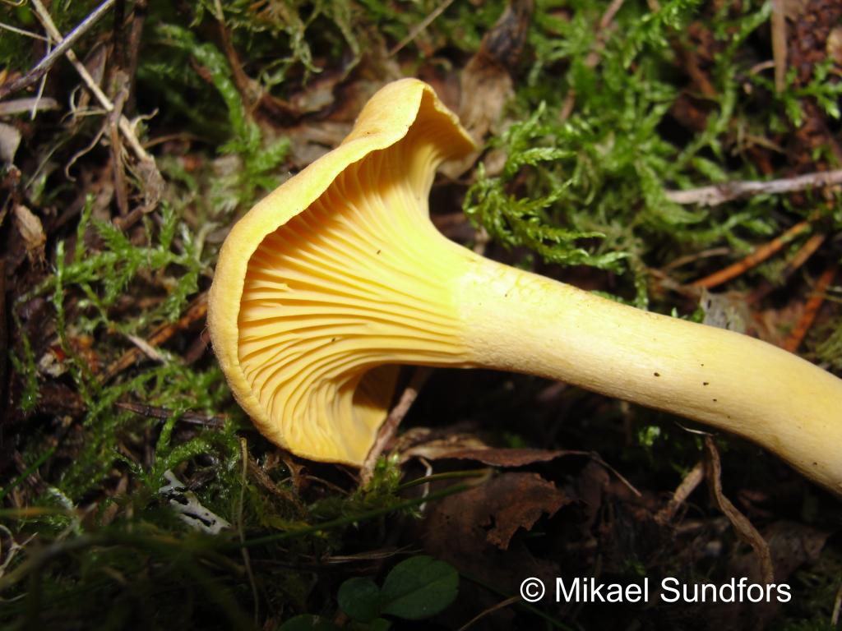
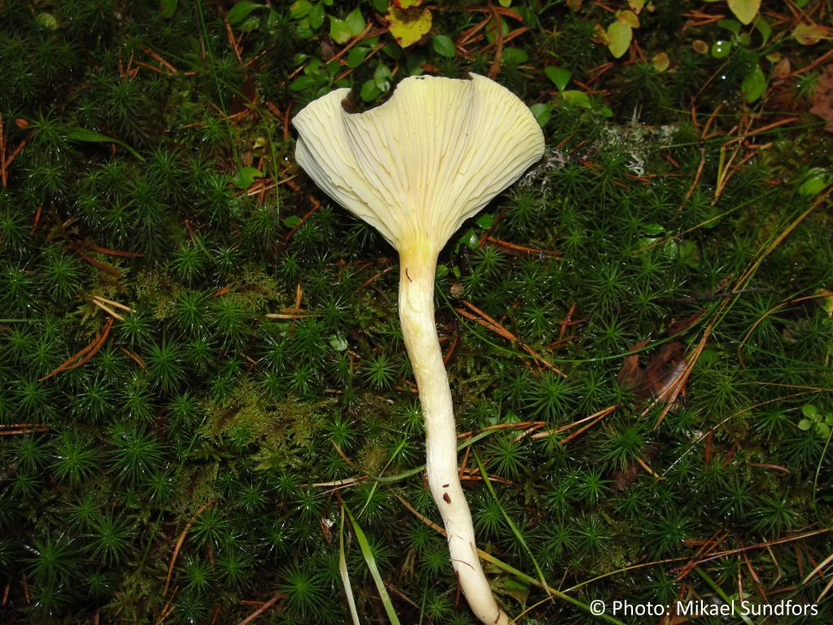
Results for Hygrophorus Hypothejus (1)
On the left, you can see the input image, and on the right you can see the similar images retrieved.
Cantharellus Cibarius (3)
Score: 1300.44
Cortinarius Collinitus (2)
Score: 1728.13
Hygrophorus Hypothejus(2)
Score: 1371.27

Slide 8
Thank for your time!
Mercury is the closest planet to the Sun

